Slide 1
VLSI Full Custom Design
Ultra Low Power 4-bit ALU
Done by:
Hassan Mohamed Hammad Omar
Ahmed El-Sousy Adham Elkholy
Supervised by:
Dr. Mohab Anis

Slide 2
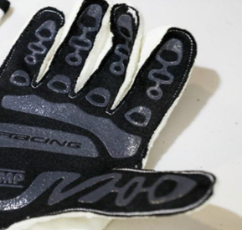

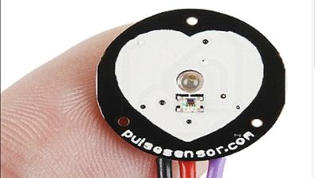

Ultra Low Power 4-bit ALU Applications
Heart rate sensor
Biometric gloves
●Such devices need to sustain long operation hours, therefore they usually use very low power.
●They usually consume around 24 mw to 90 mW

Slide 3
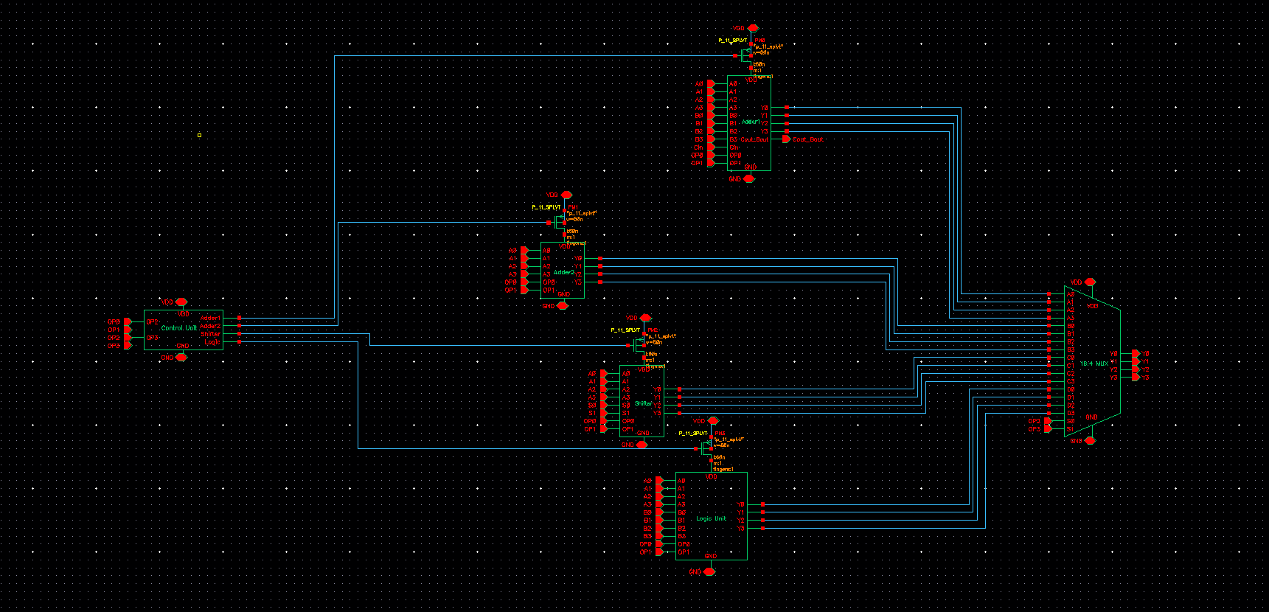
ALU Architecture

Slide 4
Power test results
Parameter | Value
Avg. Power | 0.656 uW
tpHL | 110.12 p s
tpLH | 137.15 p s

Slide 5
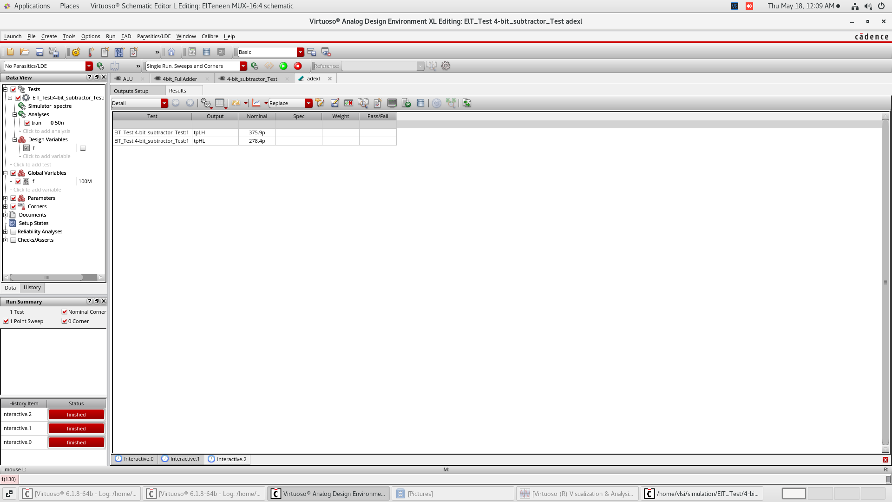
Delay of the critical path (subtraction with borrow operation)
tpHL : 278.7 ps
tpLH : 375.9 ps

Slide 6
OP-CODE and power gating logic
0000 | Add
0001 | Add with carry
0010 | Subtract
0011 | Subtract with borrow
0100 | 1s complement
0101 | 2s complement
0110 | Increment
0111 | Decrement
1000 | Shift right
1001 | Shift left
1010 | Rotate right
1011 | Rotate left
1100 | Bitwise And
1101 | Bitwise Or
1110 | Bitwise XOr
1111 | Compare

Slide 7
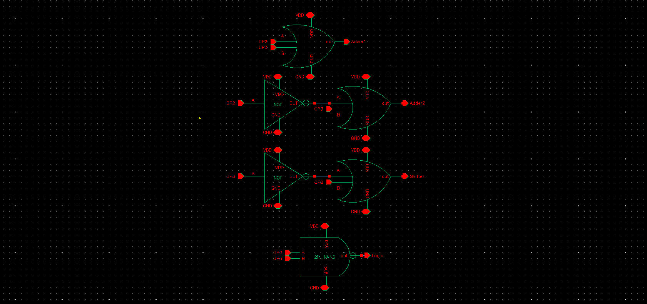
Power Gating schematic

Slide 8
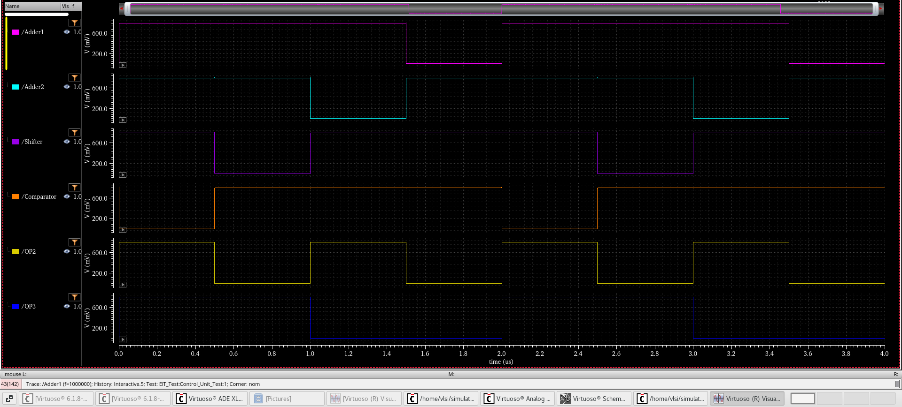
Power Gating Waveform

Slide 9
ADDER

Slide 10
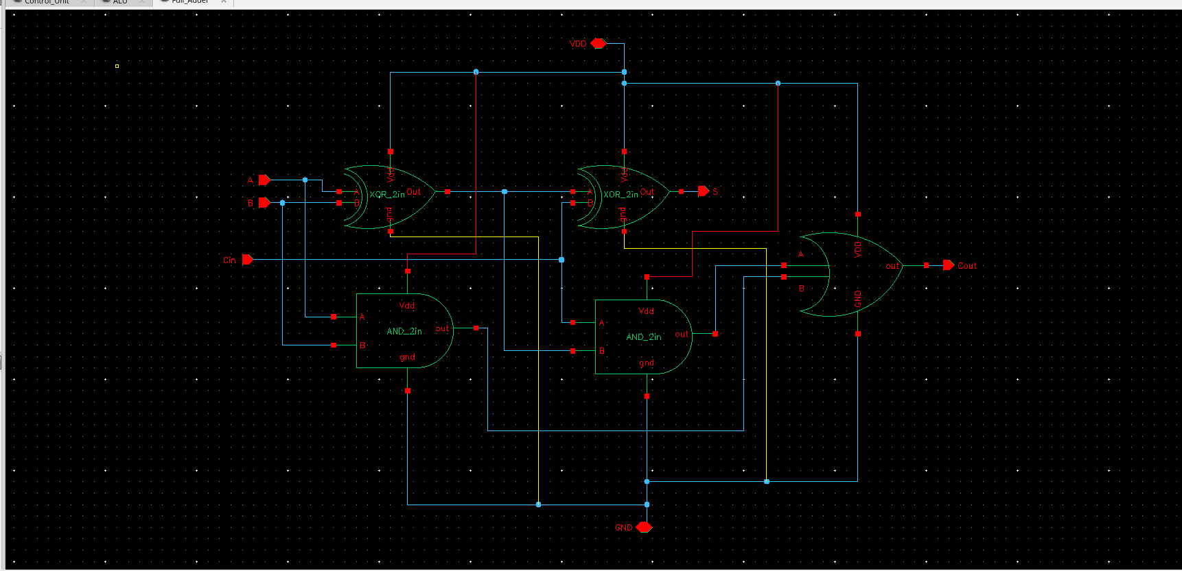
Full Adder Schematic

Slide 11
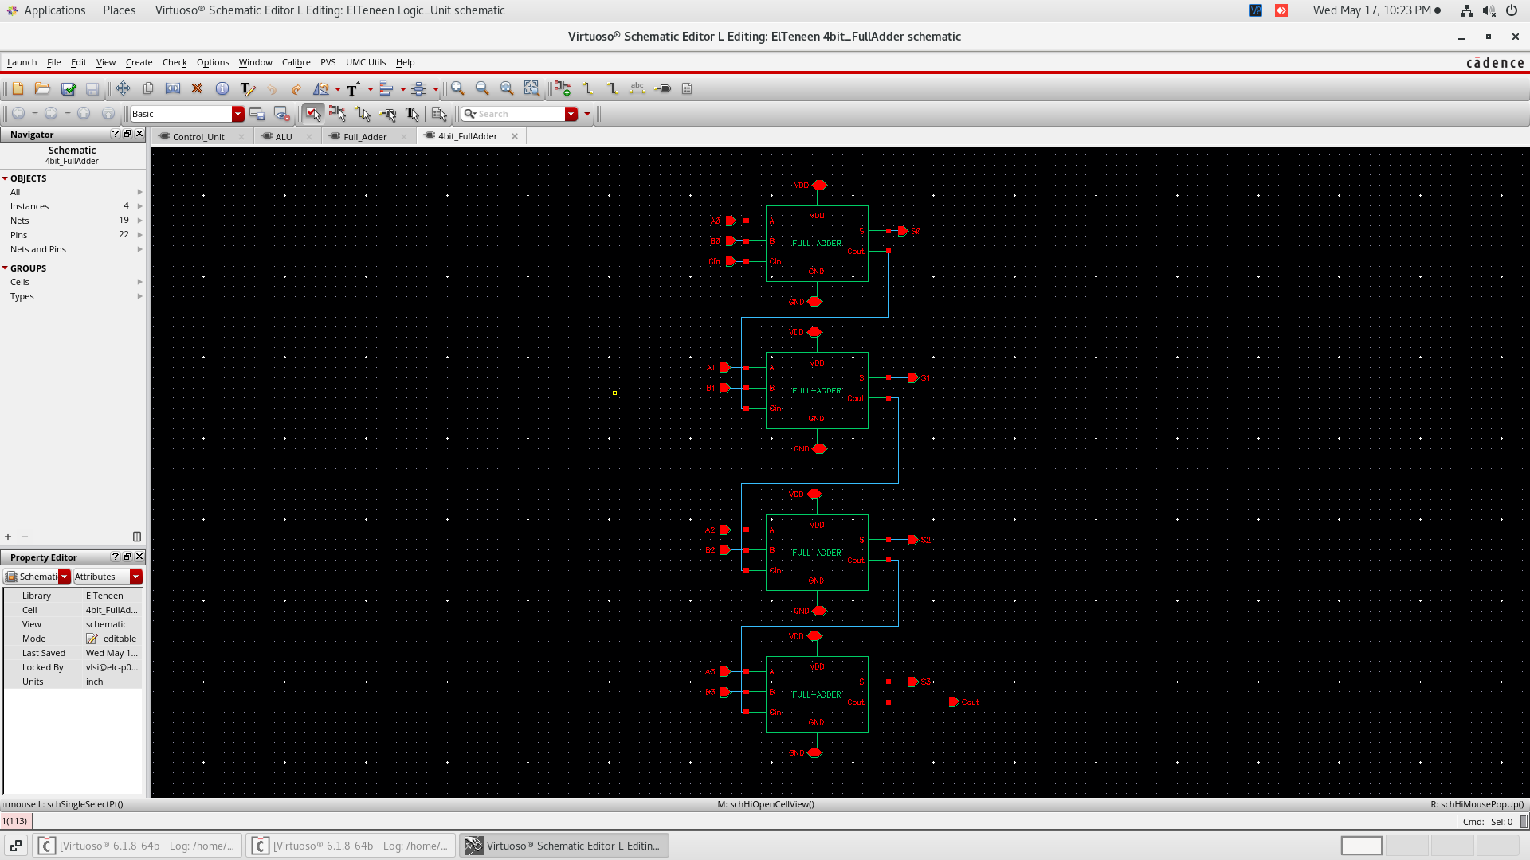
4-bit Ripple Carry Adder schematic

Slide 12
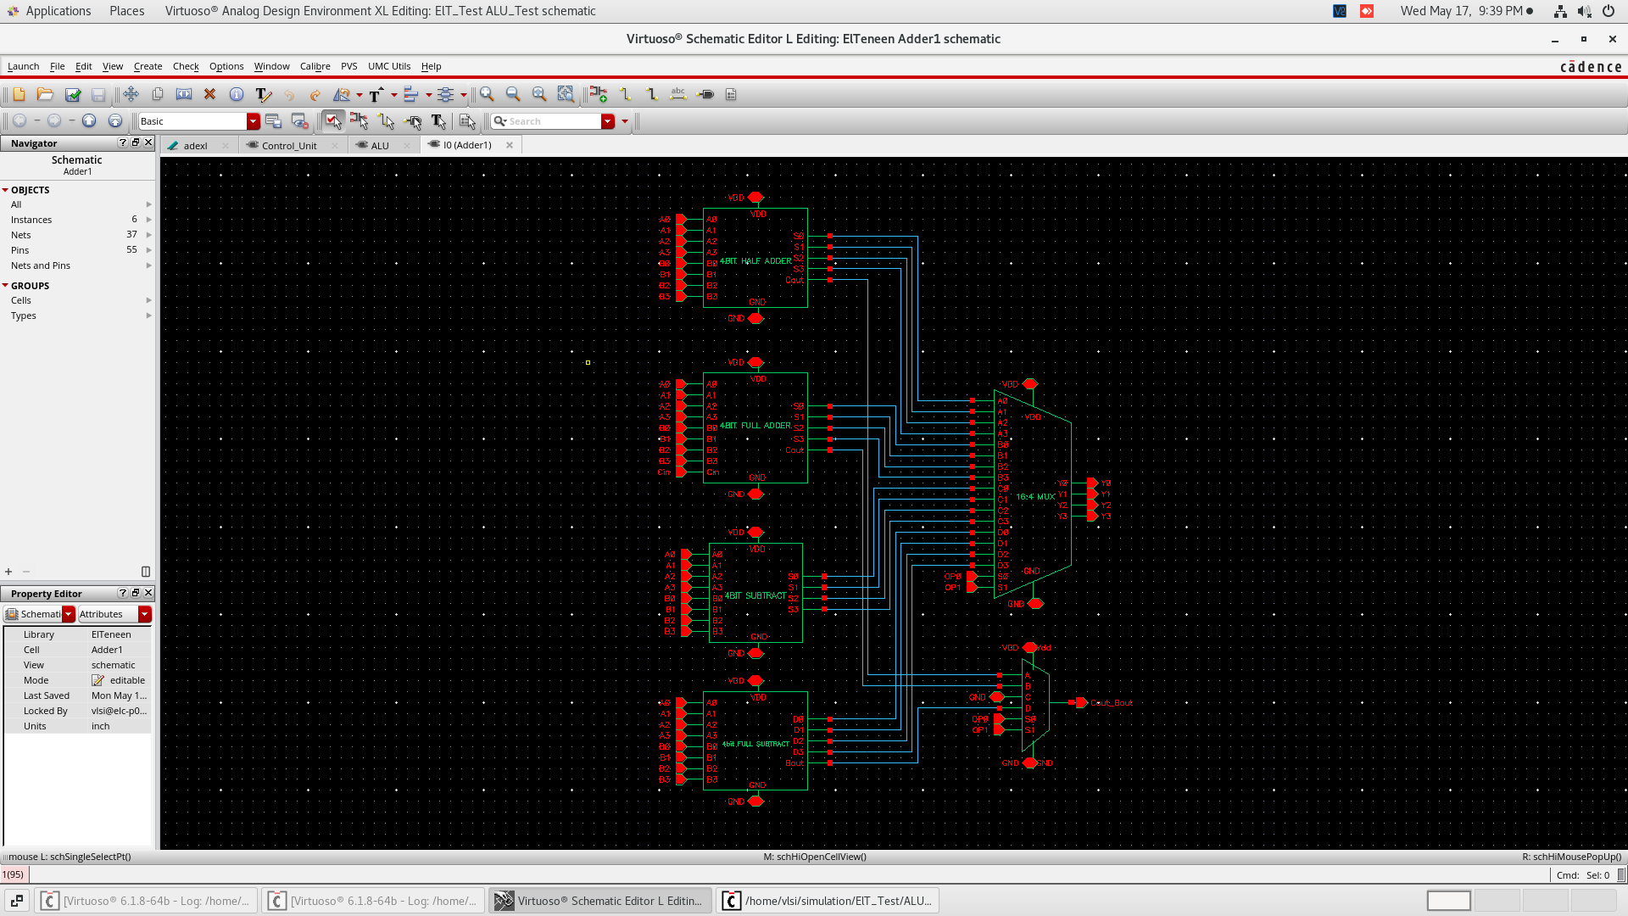
Adder 1 Schematic

Slide 13
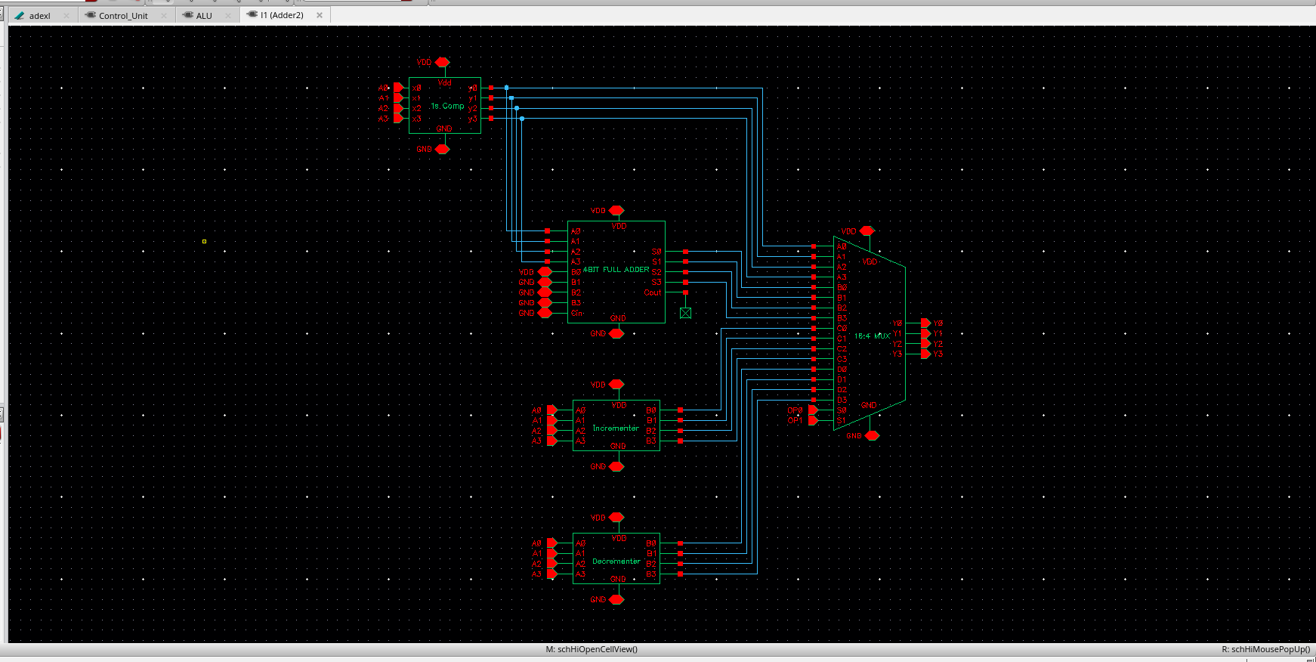
Adder 2 Schematic

Slide 14
Power and delay test results
Parameter | Value
Avg. Power | 1.056 uW
tpHL | 130.8 ps
tpLH | 105.4 ps

Slide 15
Shifters

Slide 16
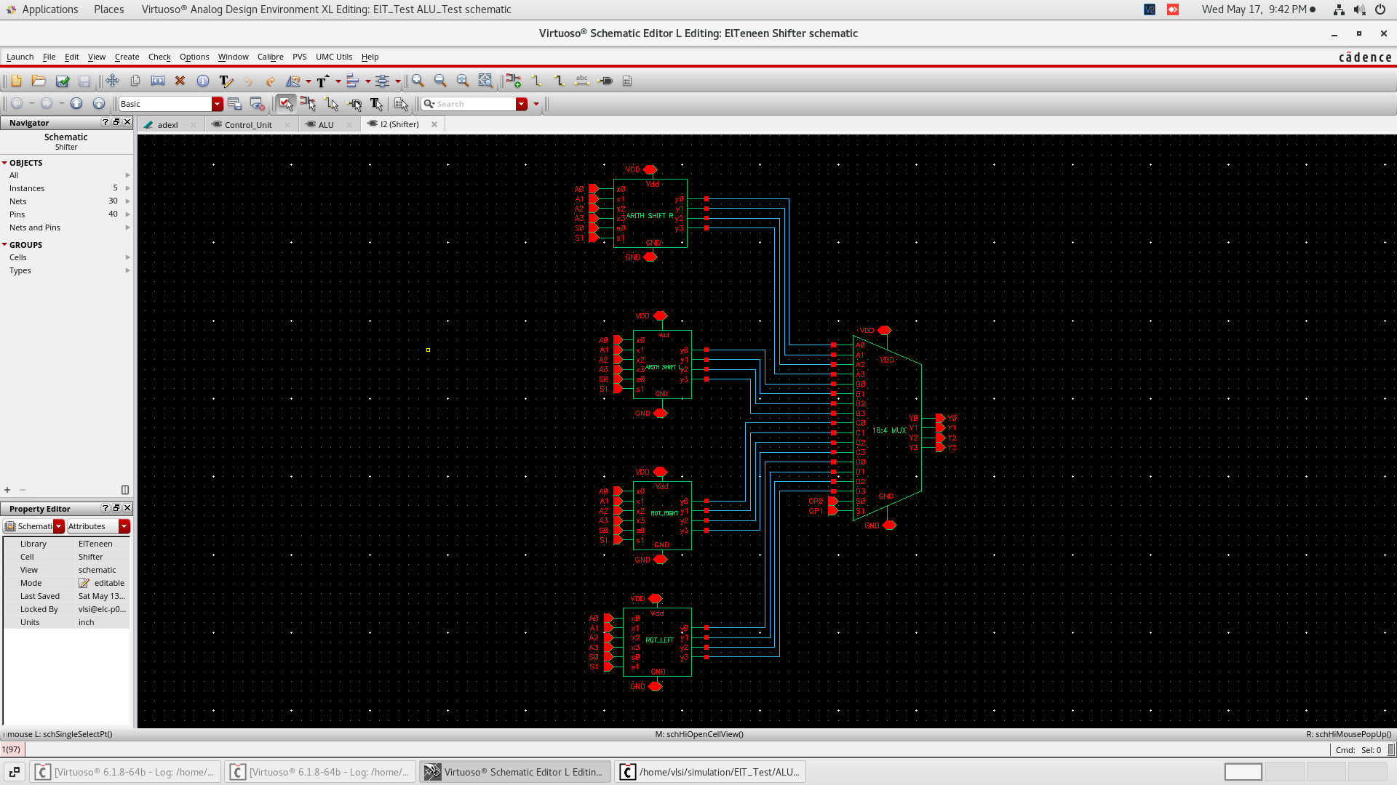
Shifter Schematic

Slide 17
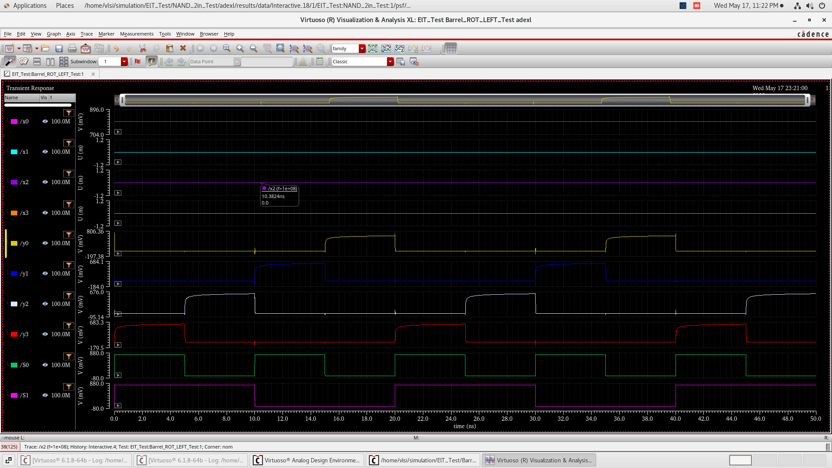
Sample of the results (Rotate Left)

Slide 18
Power and delay test results
Parameter | Value
Avg. Power | 0.371 uWatts
TPHL | 11.12 ps
TPLH | 8.746 ps

Slide 19
Comparator

Slide 20
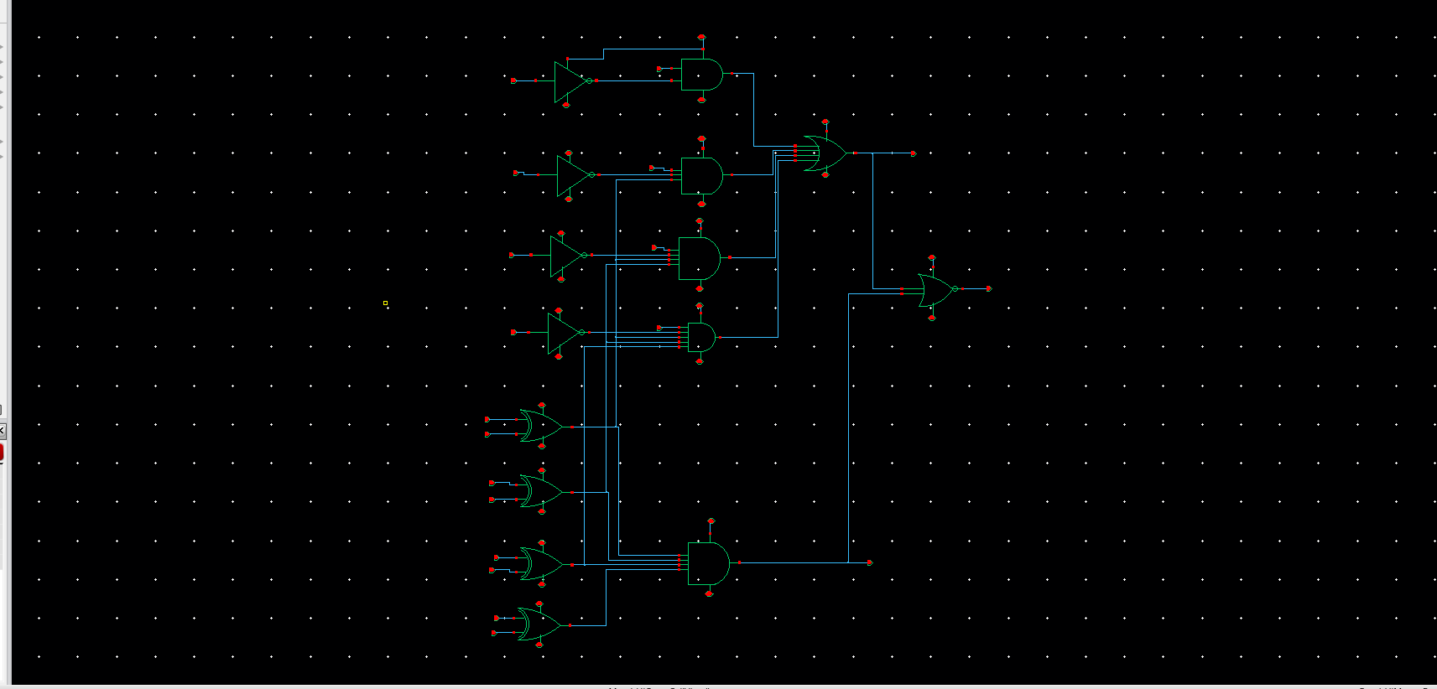
Comparator Schematic

Slide 21
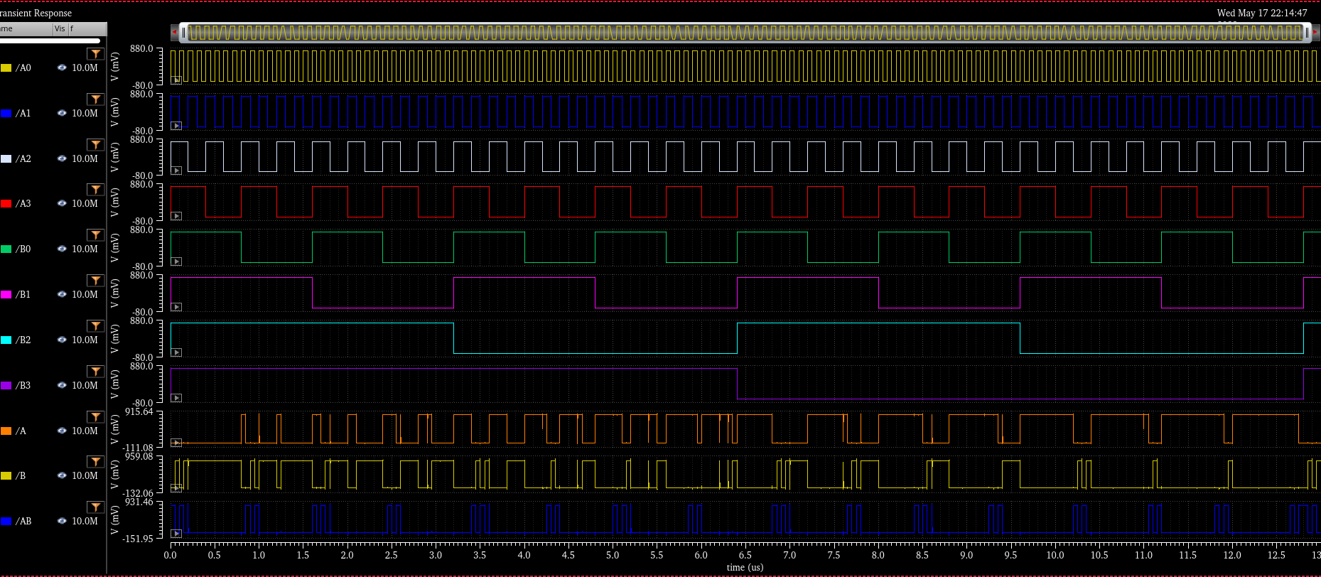
Sample of the results

Slide 22
Power and delay test results
Parameter | Value
Average Power | 0.716 uW
TPHL | 195.7 ps
TPLH | 225.1 ps

Slide 23
Logic Unit

Slide 24
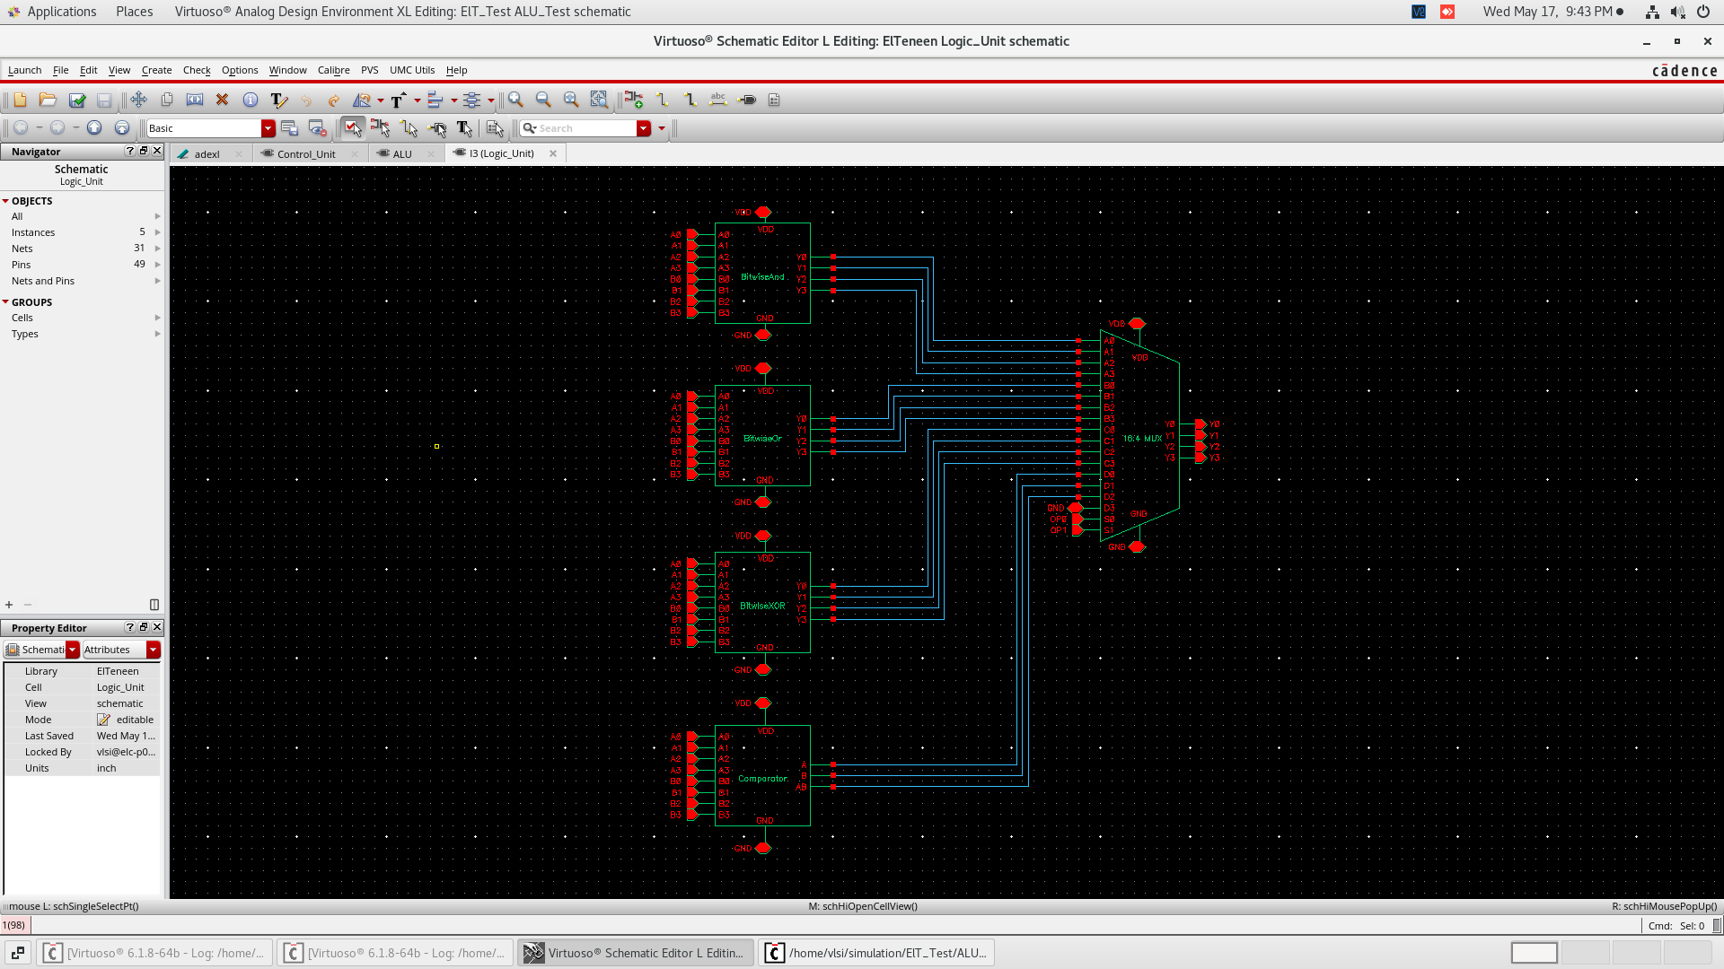
Logic unit Schematic

Slide 25
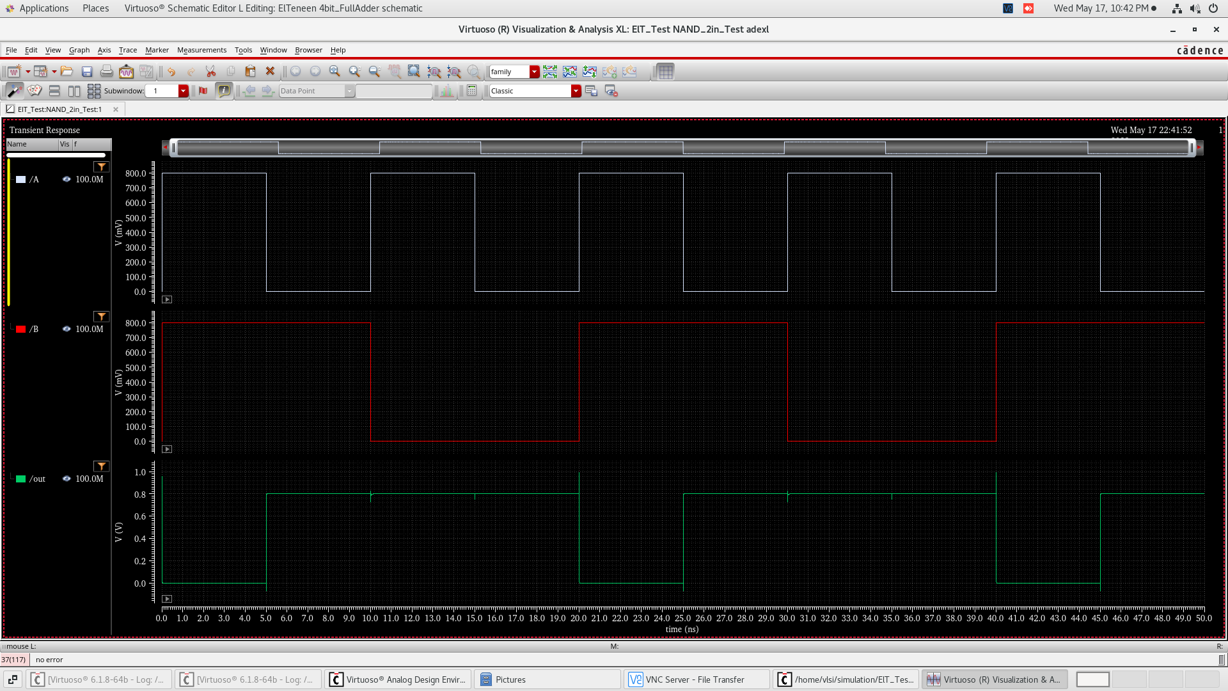
Sample of the results (NAND)

Slide 26
Power and delay test results
Parameter | Value
Average Power | 0.517 uWatts
TPHL | 122.7 ps
TPLH | 148.365 ps

Slide 27
MUX

Slide 28
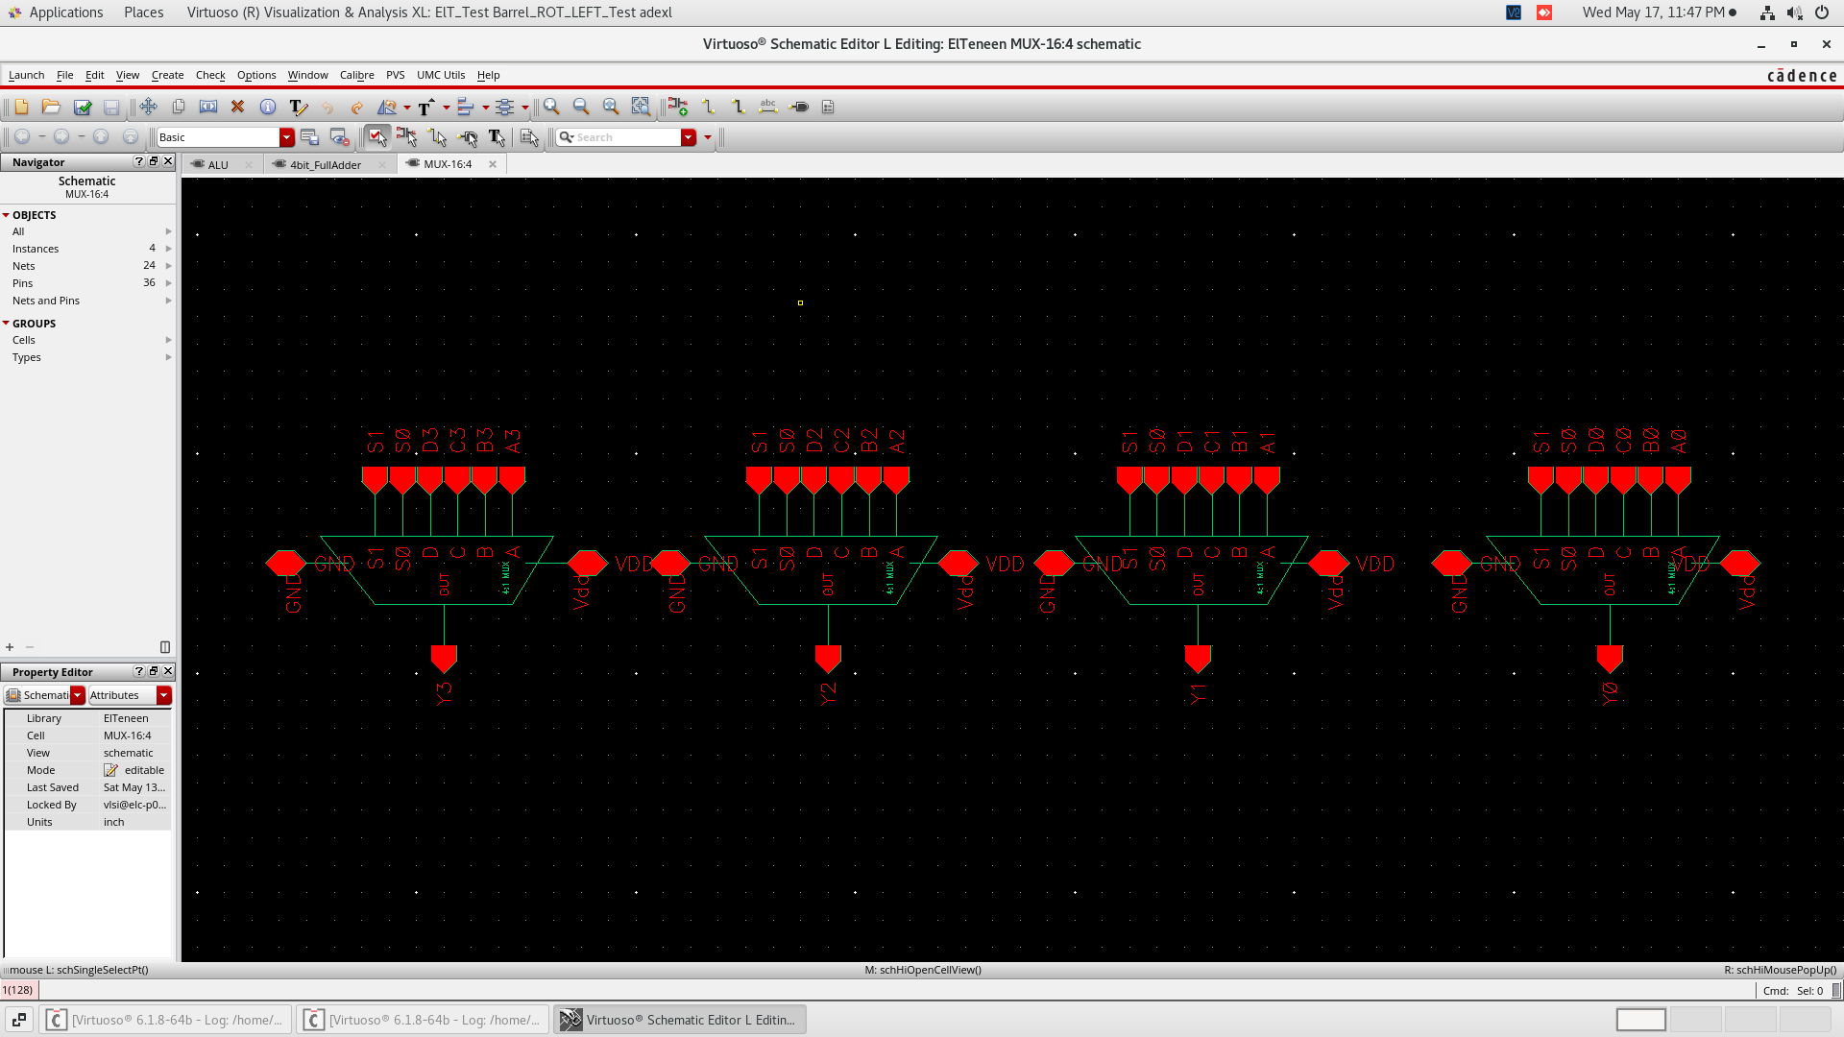
16-4 MUX schematic

Slide 29
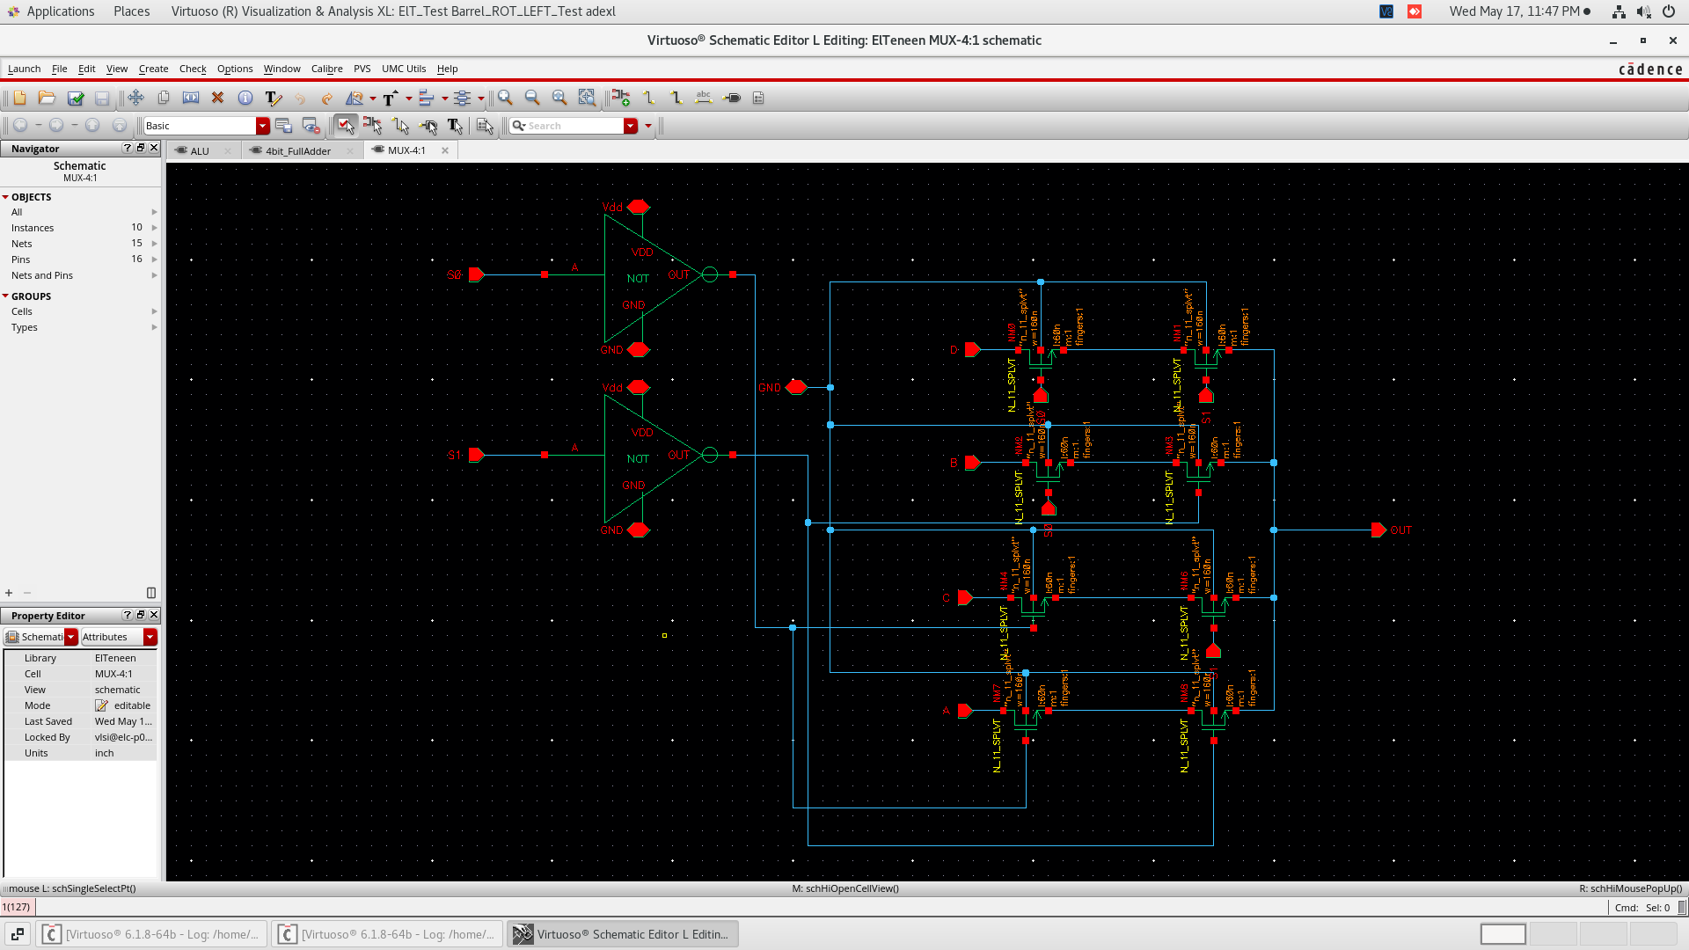
4-1 MUX schematic

Slide 30
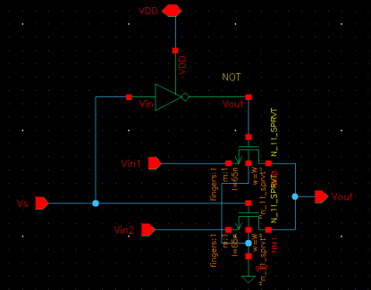
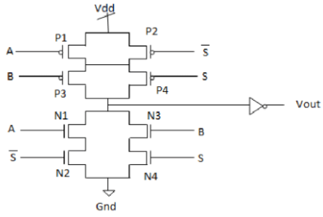
MUX 2-1 Schematic
Comparison
For optimization, a 2-1 mux implemented using CMOS will utilize 4 PMOS in the PUN & 4 NMOS in the PDN in addition to an inverter. While, PTL uses 4 transistors. Therefore, we chose the PTL implementation to minimize the # of transistors.

Slide 31
Challenges
Glitches:
Adding Buffers
Increasing Rise & Fall times
Optimizations
Calculating the critical paths
Time needed for design and testing
Decreasing complexity of circuits
Testability: The ALU requires careful design of the test circuitry and the inclusion of diagnostic features to enable easy debugging of any problems that arise.Diagnostic features are design elements that are included in a digital circuit to aid in the testing and debugging of the circuit during the manufacturing process.

Slide 32
Solutions
Glitches : Increased rise and fall times.
Optimizations: Using PTL to build some gates rather than CMOS technology .
Critical path: Simplify the circuit design: Simplifying the circuit design can help to reduce the number of critical paths and make it easier to perform the critical paths calculations. This can be achieved by using simpler logic gates, reducing the number of inputs and outputs, and minimizing the number of levels in the circuit .
Time: We started working early and finishing the gates and their sizings ASAP in order to have time for the more complex operations and circuits .
Complexity of circuits: We decreased the complexity by breaking down the more complex circuits into smaller and less complex ones, making the analysis and calculations easier.

Slide 33
Summary of the results
BLOCK | Avg. Power (μW) | TPHL (psec) | TPLH (psec)
Shifter | 0.371 | 11.12 | 8.746
Adders | 1.056 | 220.67 | 326.39
Power Gating | 0.604 | 98.61 | 101.436
Logic Unit | 0.517 | 122.7 | 148.365
16:4 MUX | 0.497 | 11.93 | 12.8
Comparator | 0.716 | 195.7 | 225.1
ALU | 0.656 | 110.12 | 137.15

Slide 34
References
Ghaderi, A., & Frounchi, J. (2016). Power and Speed Analysis of CMOS-based Multipliers using VEDIC techniques. IOSR Journal of Electrical and Electronics Engineering (IOSR-JEEE), 11, 62-68.
Ajit, A., Arathi, P. V., Haridas, K., Nambiar, N. M., & Devi, S. (2019, June). FPGA based performance comparison of different basic adder topologies with parallel processing adder. In 2019 3rd International conference on Electronics, Communication and Aerospace Technology (ICECA) (pp. 87-92). IEEE.
Misra, A., Birla, S., & Singh, N. (2020, March). Comparative analysis of various adder architectures on 28nm CMOS technology. In 2020 7th International Conference on Computing for Sustainable Global Development (INDIACom) (pp. 73-76). IEEE.
Khan, A., & Wairya, S. (2021, August). An Efficient ALU Architecture Topology for Nanotechnology Applications. In 2021 8th International Conference on Signal Processing and Integrated Networks (SPIN) (pp. 784-789). IEEE.
K. Pekmestzi and C. Efstathiou, "Design of Efficient 1's Complement Modified Booth Multiplier," 2016 Euromicro Conference on Digital System Design (DSD), Limassol, Cyprus, 2016, pp. 238-243, doi: 10.1109/DSD.2016.53.
R. Zimmermann, “Binary Adder Architectures for Cell-Based VLSI and Their Synthesis,” PhD thesis, Swiss Federal Institute of Technology, Zurich, 1997.
P. Singh and P. K. Jain, "Design and Analysis of Low Power, High Speed 4 - Bit Magnitude Comparator," 2018 International Conference on Recent Innovations in Electrical, Electronics & Communication Engineering (ICRIEECE), Bhubaneswar, India, 2018, pp. 1680-1683, doi: 10.1109/ICRIEECE44171.2018.9008504.

Slide 35
Thank you!

